Slide 1

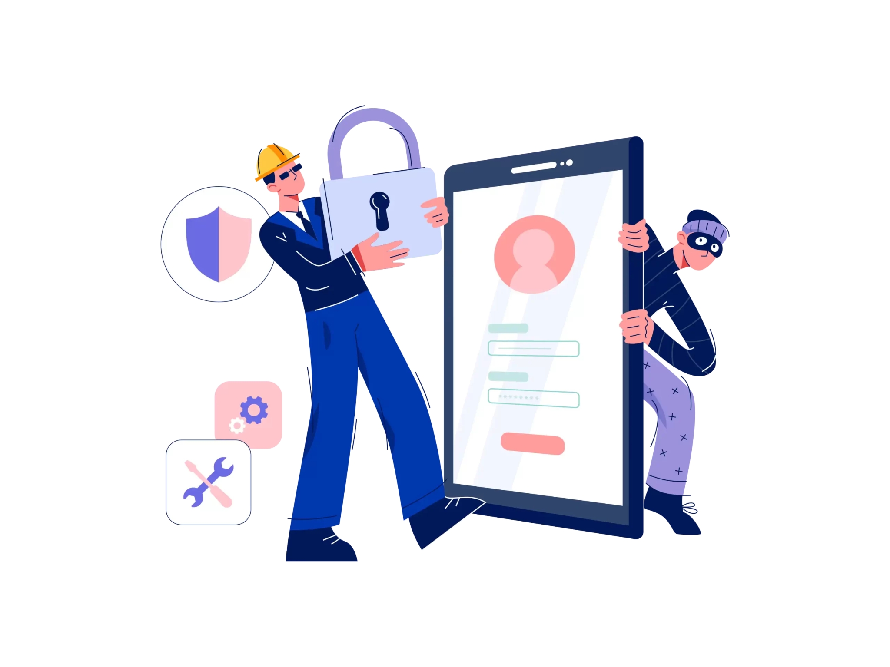
Squegg Inc.
Information Security Awareness Training Main Module
Presenter’s Name : Sahil Dubey
CISA (Certified Information Systems Auditor)

Slide 2
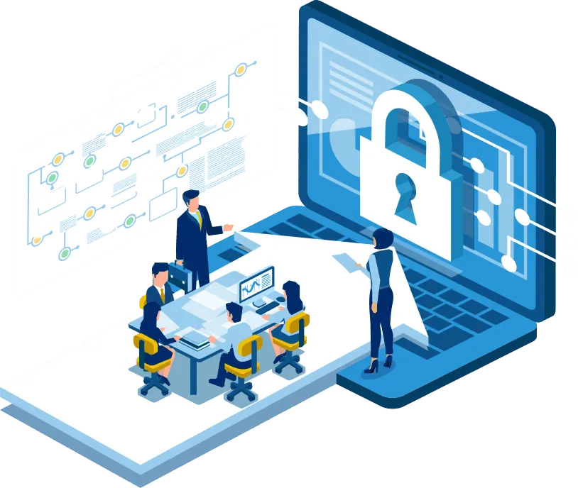
Learning Objectives :
Squegg Policy Center
Understanding what is information
Understanding Information Security
Customer Information (PII) & Privacy
Password Security
Social Engineering
Email Spam and protection
Understand and Identifying Phishing
Reporting Security Incidents
Keeping Home Network Secure
Security Awareness Quiz

Slide 3
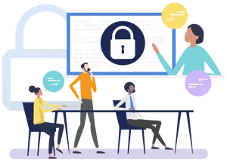
Squegg Security Policy
Visit the sharepoint location “Squegg”.
From the (“Google drive URL”)
Policies
Information Security Policies

Slide 4
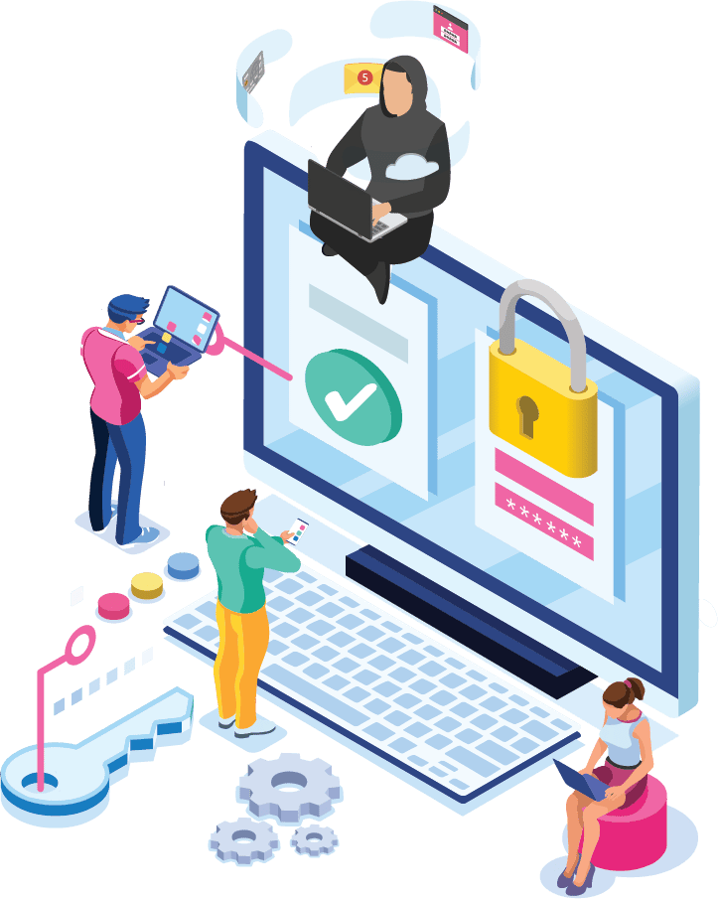
Information :
Information is an asset which, like other important business assets, has value to an organization and consequently needs to be suitably protected

Slide 5

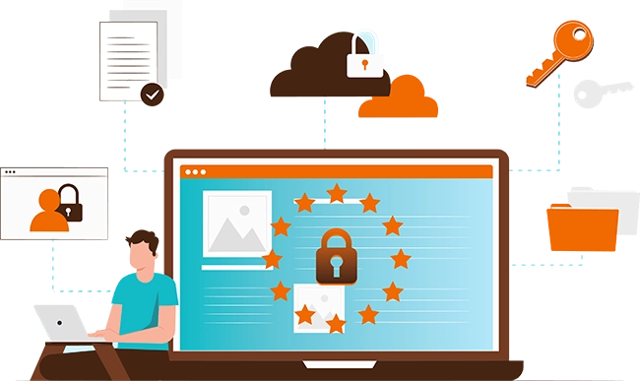
Information exists in many forms:
Printed or written on paper
Stored electronically
Transmitted by post or electronic means
Visual e.g. videos, diagrams
Published on the Web
Verbal/aural e.g. conversations, phone calls
Intangible e.g. knowledge, experience, expertise, ideas

Slide 6
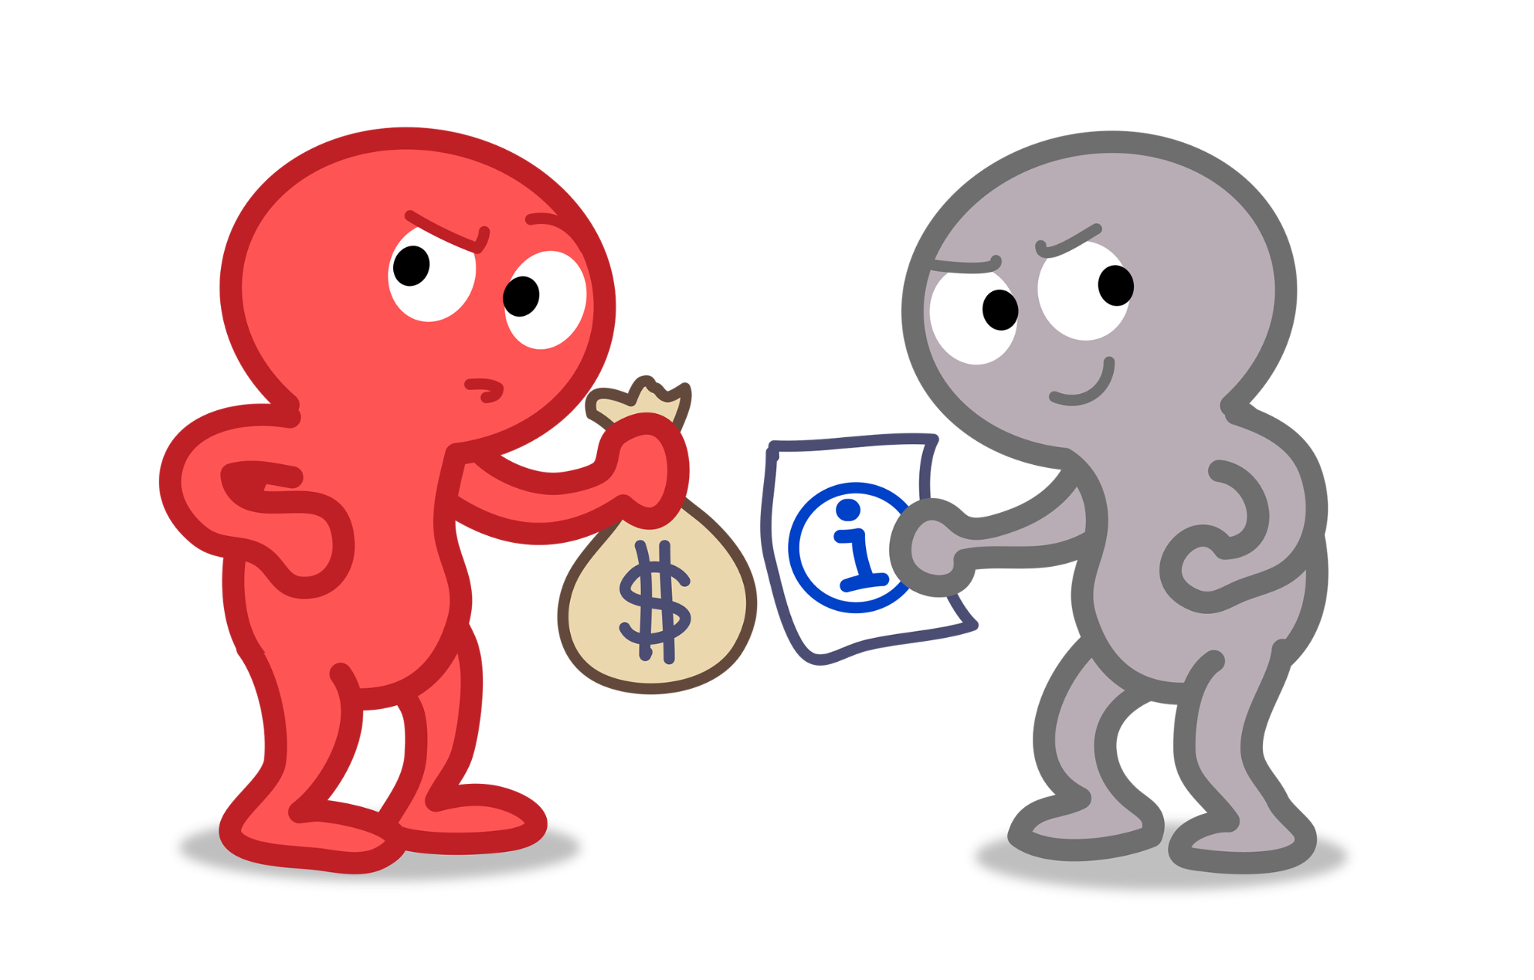
Information can be …
Created
Owned (it is an asset)
Stored
Processed
Transmitted/communicated
Used (for proper or improper purposes)
Modified or corrupted
Shared or disclosed (whether appropriately or not)
Destroyed or lost
Stolen
Controlled, secured and protected throughout its existence

Slide 7
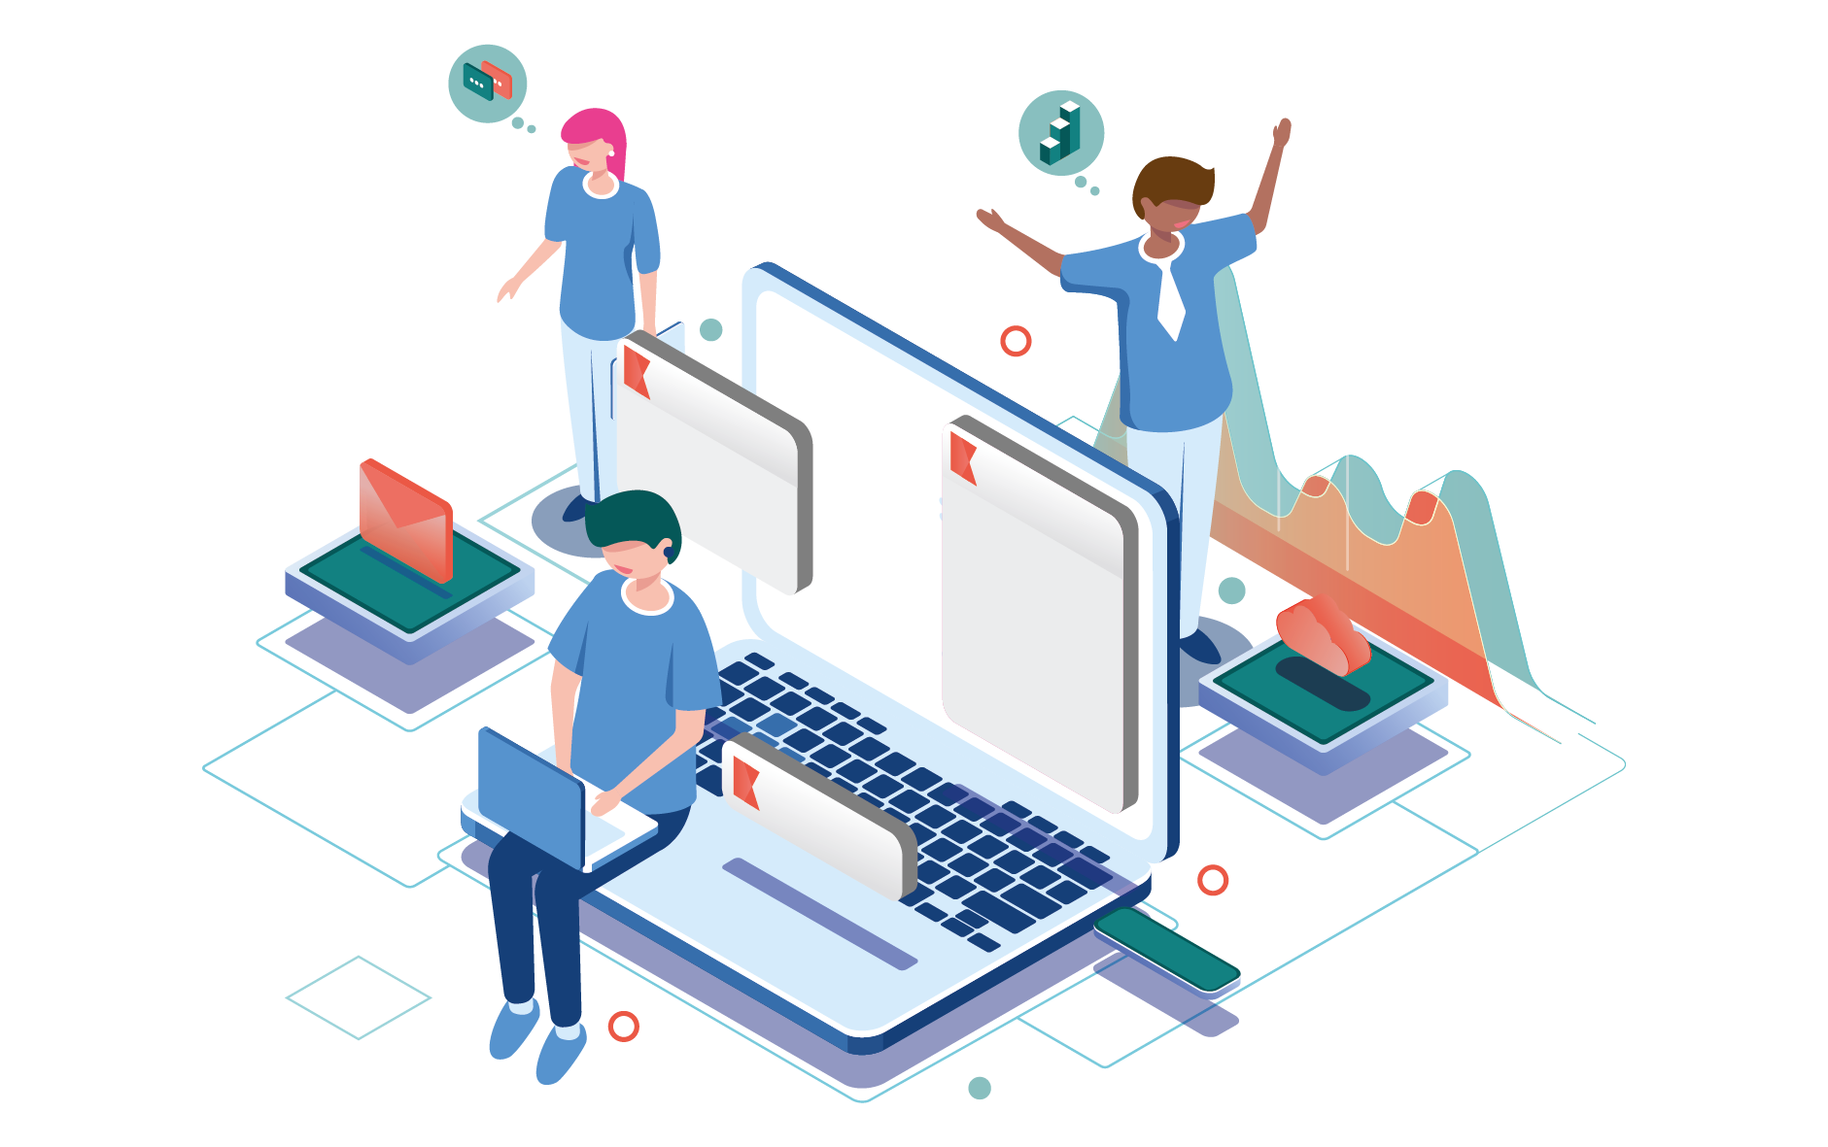
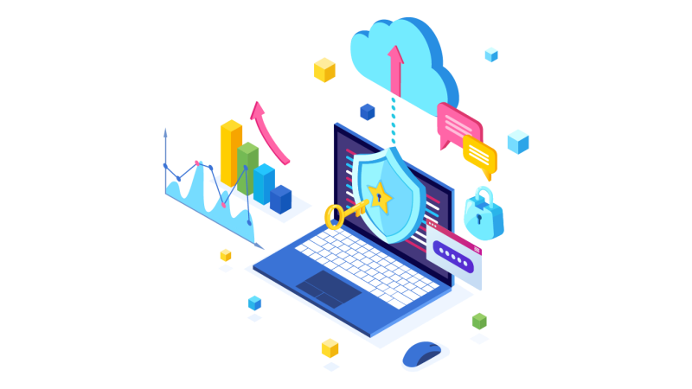
What is Information Security ?
The purpose of information security is to protect an organization’s valuable resources, such as information, computer hardware and software from unauthorized access, disclosure, modification, destruction or disruption.

Slide 8
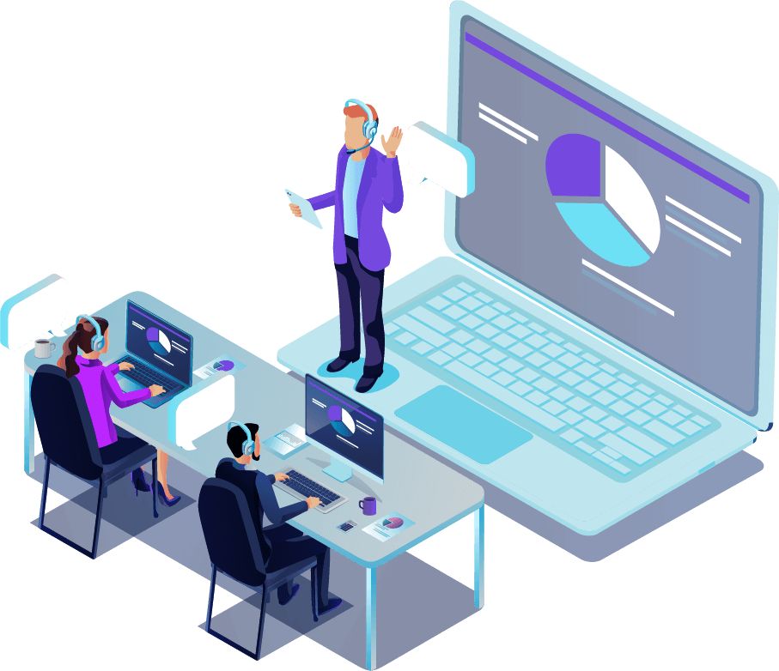
Through the selection and application of appropriate safeguards, security helps an organization’s mission by protecting its physical and financial resources, reputation, legal position, employees, and other tangible and intangible assets.
Importance of Information Security :

Slide 9
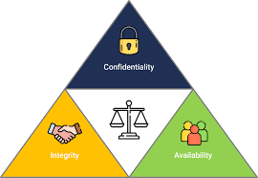
Information security is defined as the preservation of:
Confidentiality :
Making information accessible only to those authorized to use it
Safeguarding the accuracy and completeness of information and processing methods
2. Integrity :
Ensuring that information is available when required
3. Availability :

Slide 10
Security incidents cause …
IT downtime, business interruption
Financial losses and costs
Devaluation of intellectual property
Breaking laws and regulations, leading to prosecutions, fines and penalties
Reputation and brand damage leading to loss of customer, market, business partner or owners’ confidence and lost business
Fear, uncertainty and doubt

Slide 11
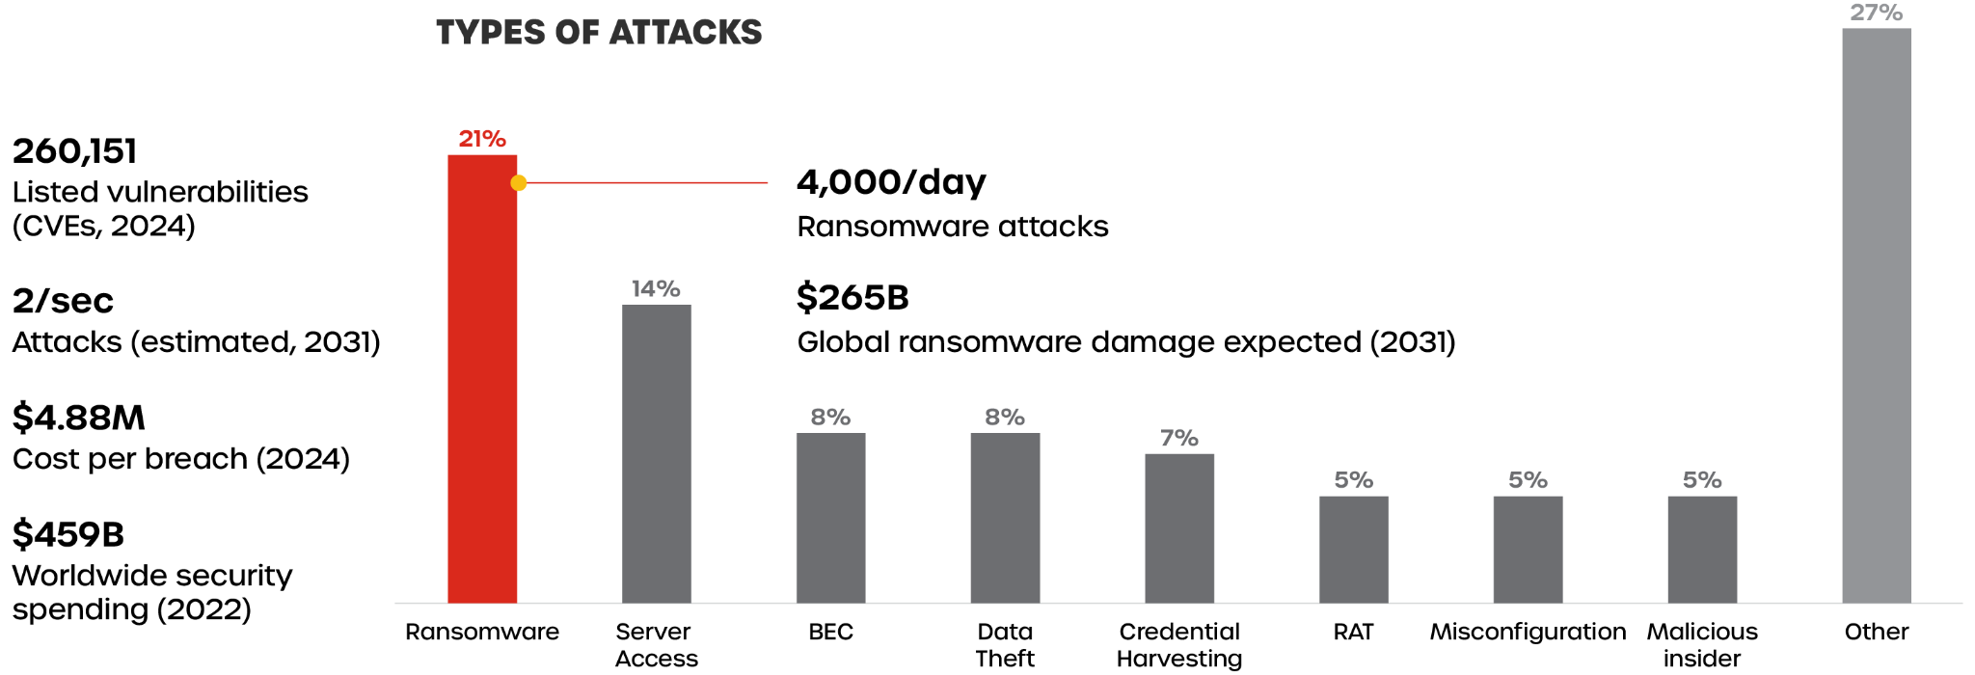
Cybercrime Statistics

Slide 12
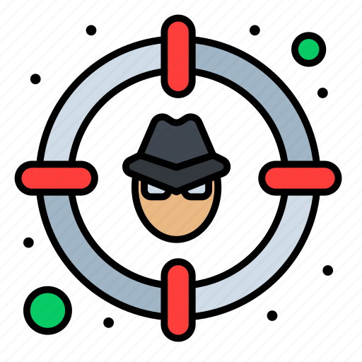
You Are the Target :
Anyone with an identity, computer or private information is a target.
Security risks exist regardless if you are at work or at home

Slide 13
Is Information Security just an IT Problem?
Good Security Standards follow the “90 / 10” Rule:
10% of security safeguards are technical
90% of security safeguards rely on the computer user (“YOU”) to adhere to good computing practices
Example: The lock on the door is the 10%. You remembering to lock the lock, checking to see if the door is closed, ensuring others do not prop the door open, keeping control of the keys, etc. is the 90%. You need both parts for effective security.

Slide 14
Customer Sensitive Information / PII (Personally Identifiable Information)
Identity: Identity is made up of any name, number, or attribute that provides information on us or allows access into further personal data about us. Identity is almost always used to link us to money, special privileges,or access.
PII Information: is any information of a customers, suppliers, or employees, Squegg employees, and any other individual that is created, received, compiled, processed, accessed, maintained, used, or managed by Squegg and relates to an identified or identifiable individual, including any information that could be used, either alone or with other information, to identify an individual.

Slide 15
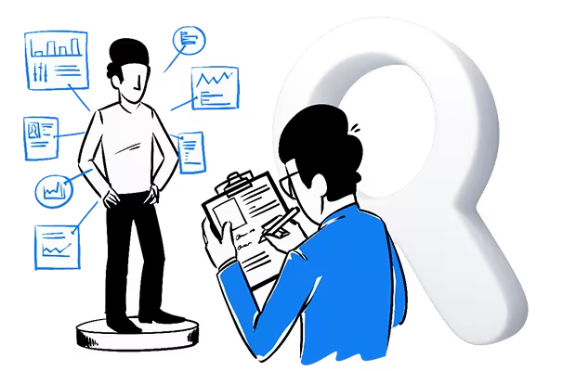
Common Examples of PII:
Full Name
Current and Previous addresses
Driver’s License number
Bank Account Numbers
Credit/Debit Card Numbers
Pay/Financial Information
Social Security number (SSN)
Date of birth (DOB)
Medical Information

Slide 16
Customer/Client Sensitive Information / PII (Personally Identifiable Information) :
As a member of the Squegg
workforce, you are responsible for :
Not collecting, using, disclosing and storing personal information unless specifically required to perform job function
Accessing and processing information only for authorized purposes
Compliance with all Squegg security policies and procedures
Reporting suspected privacy violations or incidents
Note: Non Compliance with security policies and procedures will invite disciplinary action as per reprimand process.

Slide 17
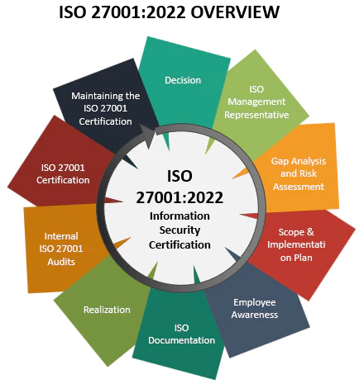
ISO 27001:2022 Controls & Framework
Information security policies and organization
Human resource and asset management
Access control, cryptography, and physical security
Operations, communications, and supplier security
Incident management, business continuity, and compliance

Slide 18
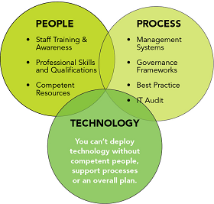
Protecting People, Processes, and Technologies
People: Security awareness, defined roles, background checks
Processes: Documented policies, risk management, incident response, audits
Technologies: Access controls, encryption, secure configuration, backups

Slide 19
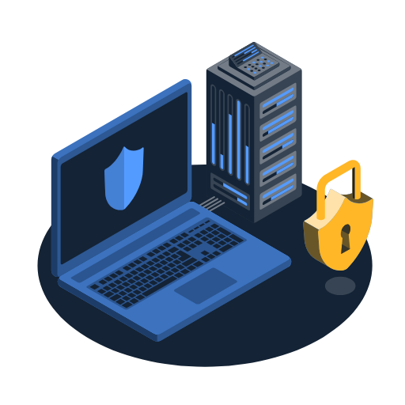
Security Responsibilities for All Staff
Do not share or write down passwords
Report incidents or suspicious activities immediately
Access only information necessary for your role
Follow company policies for sensitive data
Lock your computer when away

Slide 20
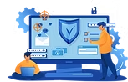
Security Best Practices for IT & Developers
Secure system configuration and regular updates
Monitor access logs and respond to anomalies
Use encryption for sensitive data
Secure coding practices and vulnerability testing
Document system changes and security features

Slide 21
Key Takeaways & Benefits of ISO 27001:2022
ISO 27001:2022 provides a robust security framework
Protecting people, processes, and technologies is essential
Compliance reduces risk and builds trust
Everyone plays a role in information security
Report incidents and follow policies

Slide 22
ID & Passwords
Each employee must have a unique User ID and Password. Password construction is vitally important since the password is the key to unlocking access to our data. Follow the "do’s" and "don’ts" lists below for more information.
Do’s
Use long passphrases (12–16+ characters) for stronger security.
Mix uppercase, lowercase, numbers, and symbols in your passwords.
Create unique passwords for every account.
Use a reputable password manager to generate and store passwords.
Enable multi-factor authentication (MFA) wherever possible.
Change your password immediately if you suspect it’s been compromised.
Regularly check if your credentials have been exposed in breaches (e.g., “Have I Been Pwned”).
Memorize your master password or passphrase; don’t write it down.
Type your password in private and ensure no one is watching.
Keep your devices and software updated to protect your accounts.

Slide 23
Don’t use shared or network logins for personal accounts.
Don’t use information easily found about you (like names, birthdays, or phone numbers) in your password.
Don’t use passwords made up of only numbers or only letters.
Don’t use dates, keyboard patterns (e.g., qwerty), or repeated characters.
Don’t use common or sample passwords (e.g., “password”, “123456”).
Don’t reuse passwords across multiple accounts.
Don’t write passwords where others can see or access them.
Don’t share your password with anyone.
Don’t ignore multi-factor authentication—enable it whenever possible.
Don’t use passwords exposed in data breaches (check with services like “Have I Been Pwned”).
Don’ts

Slide 24
Protection Against Malicious Software
We has implemented effective anti-virus software (Windows Defender) to:
Reduce the exposure of our client’s information to computer viruses,
Ensure the timely detection of computer viruses, and
Provide a reliable means to contain and eradicate computer viruses if they do occur
As an end user , please ensure this software remains configured to automatically update its anti-virus definitions and to automatically scan your workstation and hard drive on a routine basis.
If you notice that the virus definitions are not up to date or the antivirus software is malfunctioning then please contact the IT Service Desk for help.

Slide 25
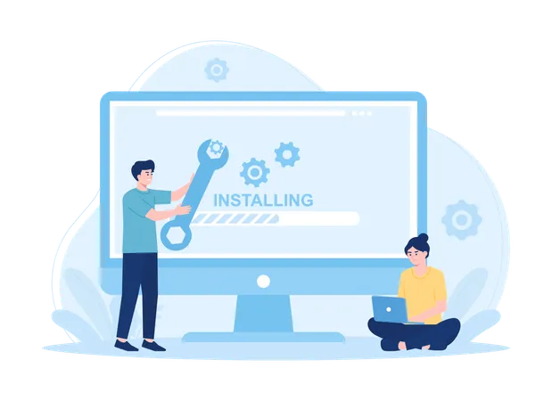
Software Installation
Local Workstation Management Group are the only individuals authorized to install software on company computers.
Installation of any software package on Squegg computers by an employee, especially software downloaded from the Internet, is considered a violation of Acceptable use policy.
Unauthorized software introduces several vulnerabilities:
The software could introduce a virus
The software could conflict with or corrupt existing software
The software could create a licensing issue
Do not install any programs of any kind, for any reason.

Slide 26
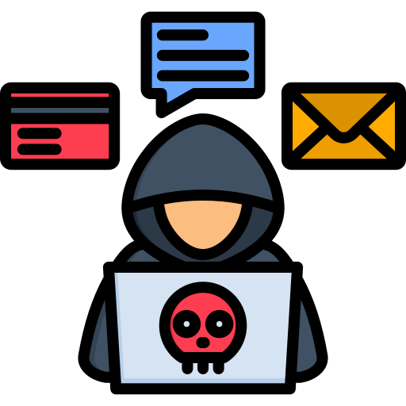
Social Engineering
Social engineering is a hacker's clever use of the natural human tendency to trust.
The hacker's goal is to obtain information that will allow him/her to access a system and its information.
Usually social engineering is conducted by phone.
The caller will imitate someone in a position of authority and gradually get information from an unsuspecting employee.
When in doubt, hang up the phone and contact Information Security Team/ Your Supervisor.

Slide 27
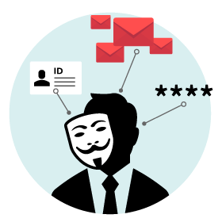
Social Engineering Indicators:
Refusal – The caller Refuses to give you their contact information.
Rushing - "I'm on my cell phone, my battery is dying. I'll call you back.
Name-Dropping -. "Your President, Mr. Smith told me to call you as you are the expert on this subject."
Intimidation - "I've been transferred four times, let me have your name, if you don't help me..."

Slide 28
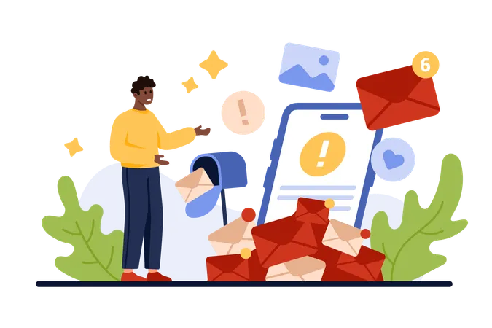
Email SPAM & Countermeasures
Human Behavior
Social engineering attacks are based on natural human desires like:
Trust
Desire to help
Desire to avoid conflict
Fear
Curiosity
Ignorance and carelessness
Social engineers will gain information by exploiting the desire of humans to trust and help each other.

Slide 29
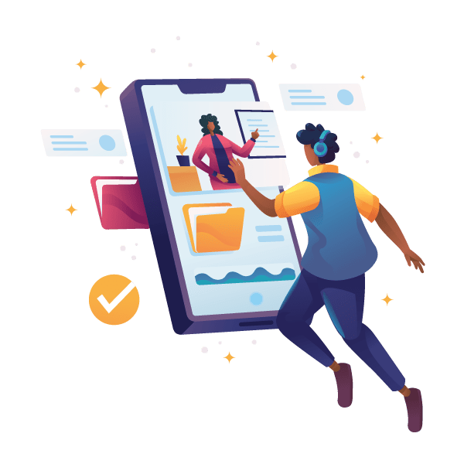
Email SPAM & Countermeasures
Usually include the aspects that email is unsolicited and sent in bulk.
Nearly identical messages sent to numerous recipients by email
Clicking on links in spam email may send users to phishing web sites or sites that are hosting malware.
Spam email may also include malware as scripts or other executable file attachments.

Slide 30
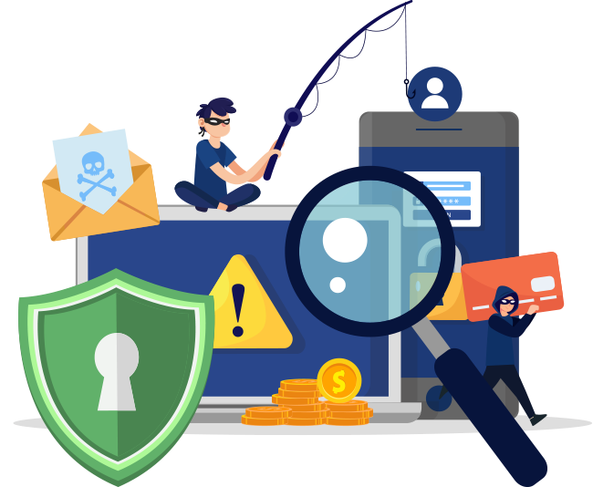
Countermeasures:
Do not click on links in such emails
Do not download and open attachments
Keep Antivirus definition up to date
Keep operating system security patches up to date
Ensure security updates are installed for third party applications such as Java/flash etc..
Contact Security team when in doubt

Slide 31
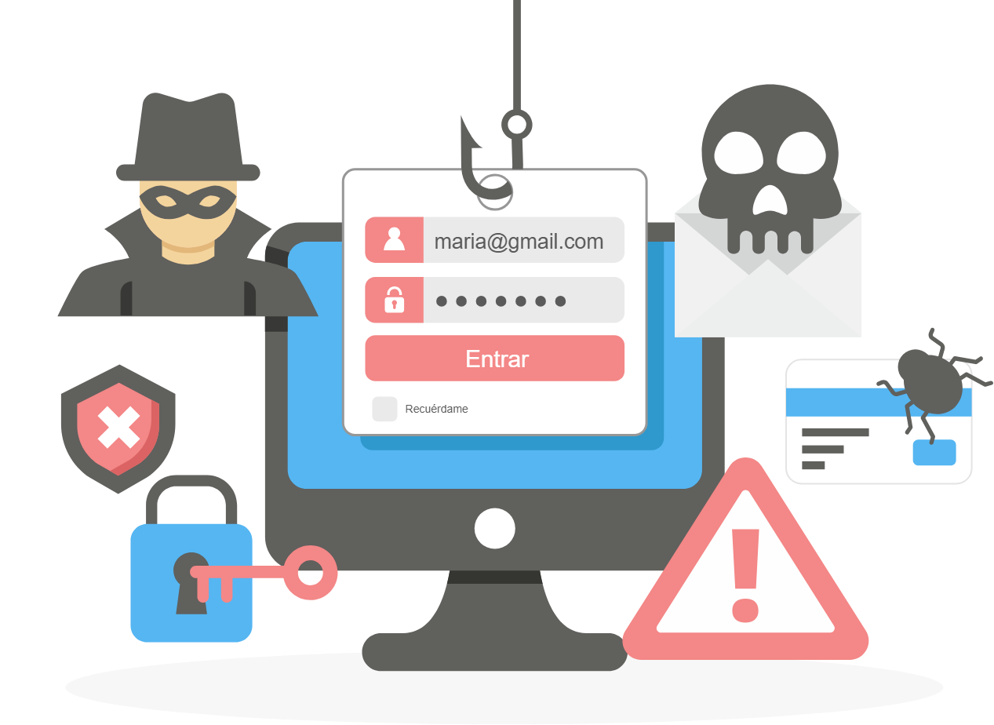
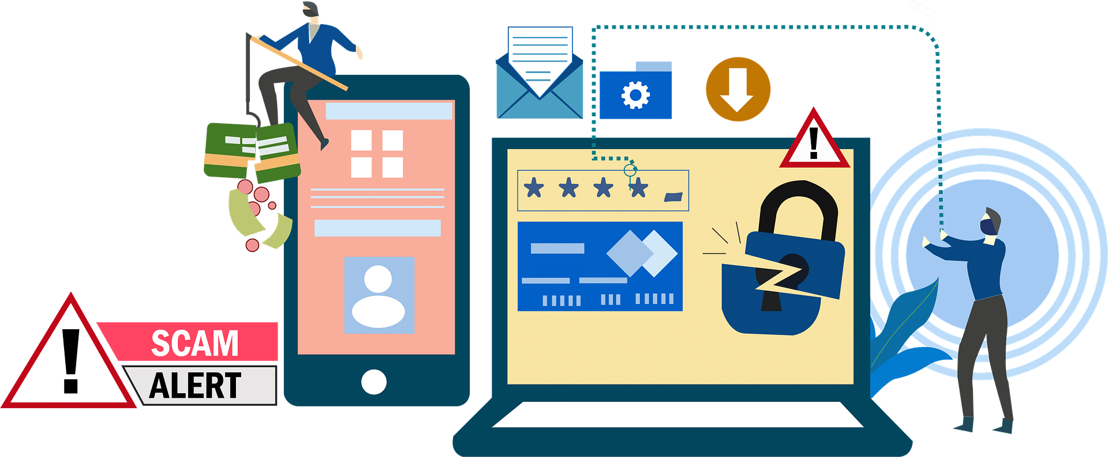
Phishing
A scam designed to
Steal information or passwords,
Compromise computers or
Trick you out of money
Typically via deceptive emails, texts, posts on social networking sites, pop-ups or phone calls.

Slide 32
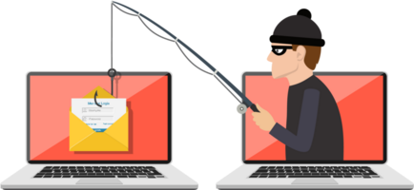
Combat Phishing
NEVER provide your password to anyone via email.
Be suspicious of any email that:
Requests personal information.
Contains spelling and grammatical errors.
Asks you to click on a link.
Is unexpected or from a company or organization with whom you do not have a relationship.
If you are suspicious of an email:
Do not click on the links provided in the email.
Do not open any attachments in the email.
Do not provide personal information or financial data.
Do forward the email to the IT Service Desk.

Slide 33
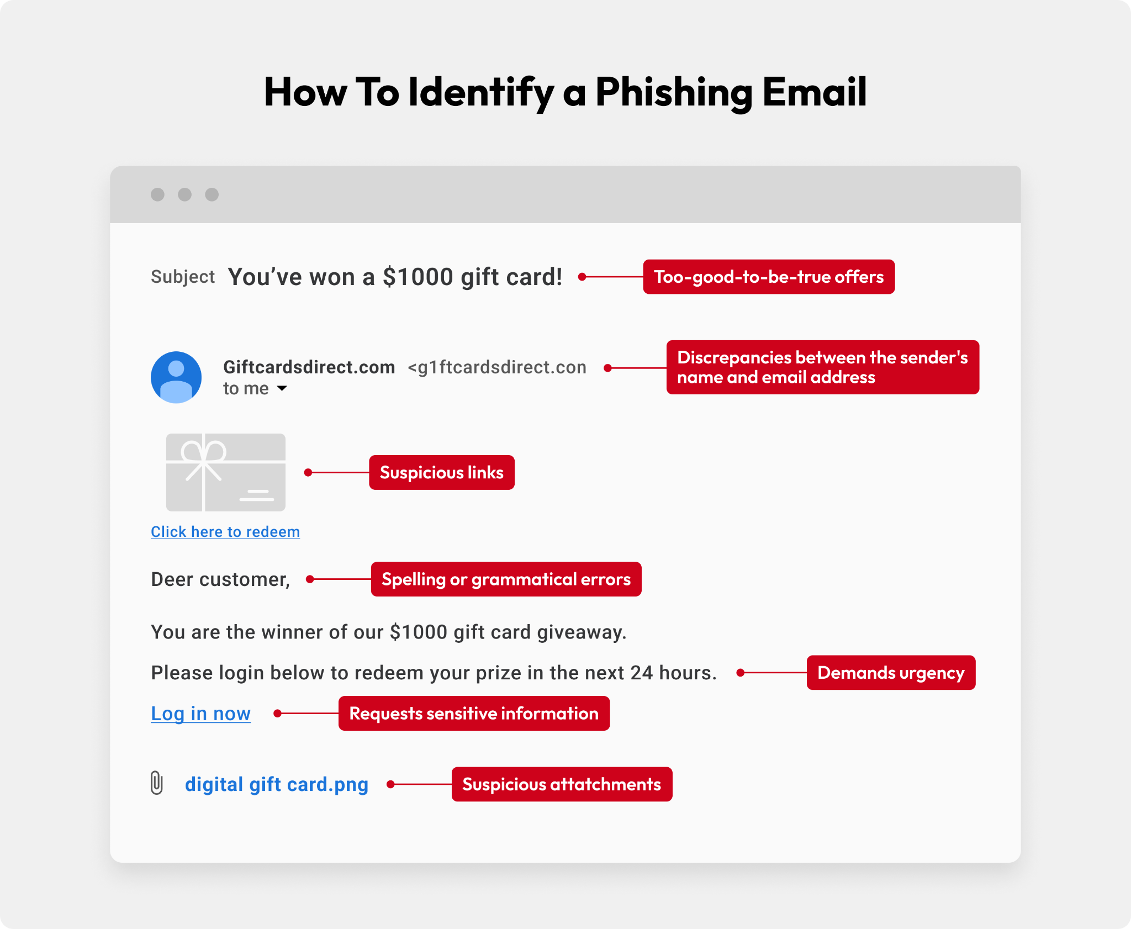
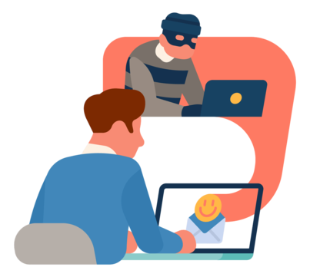
How To Spot A Phishing Email

Slide 34
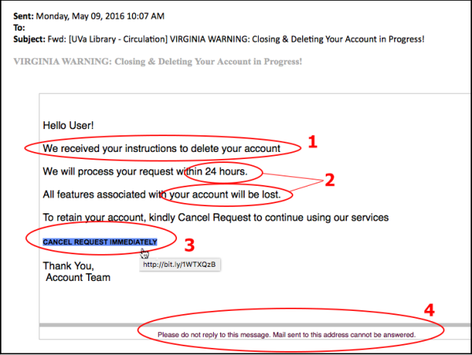
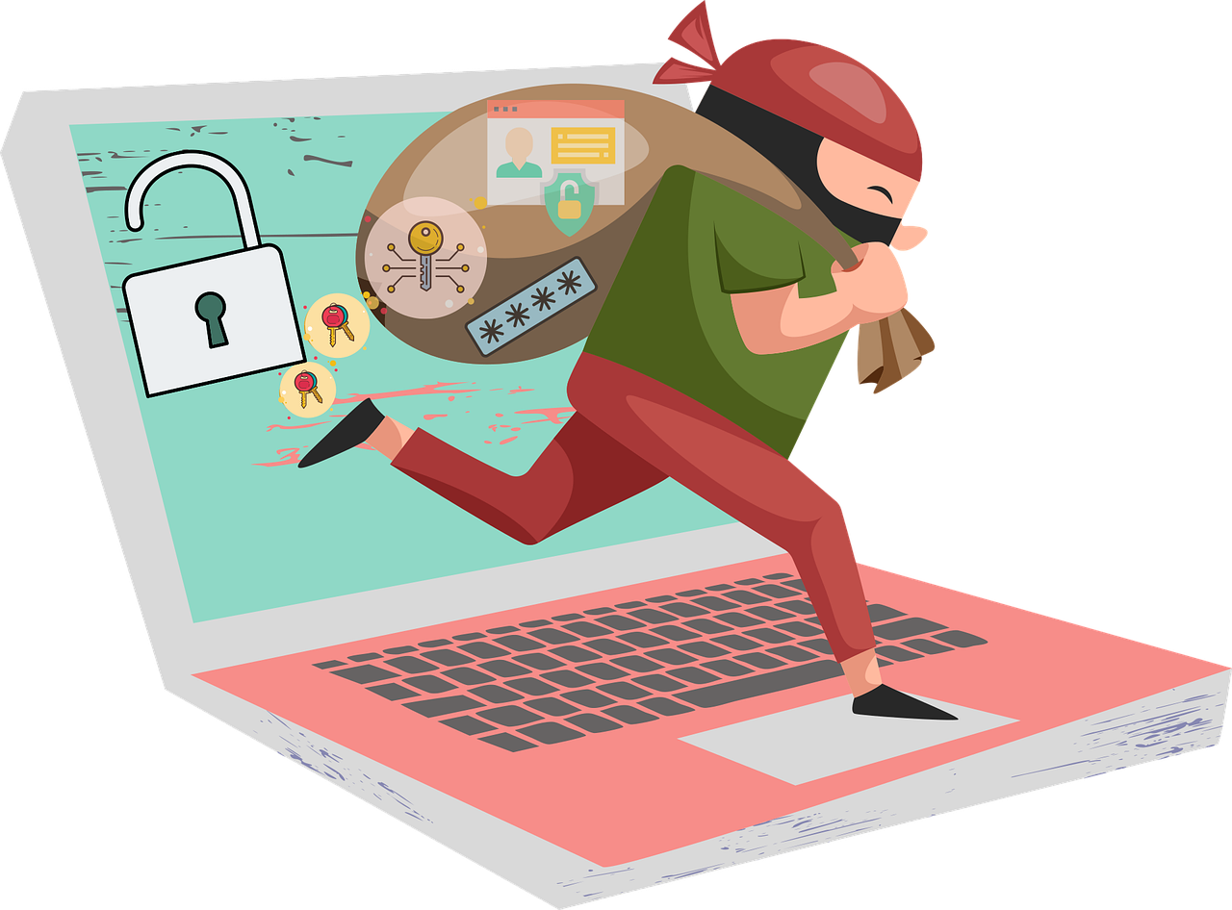
Malicious Email Sample

Slide 35
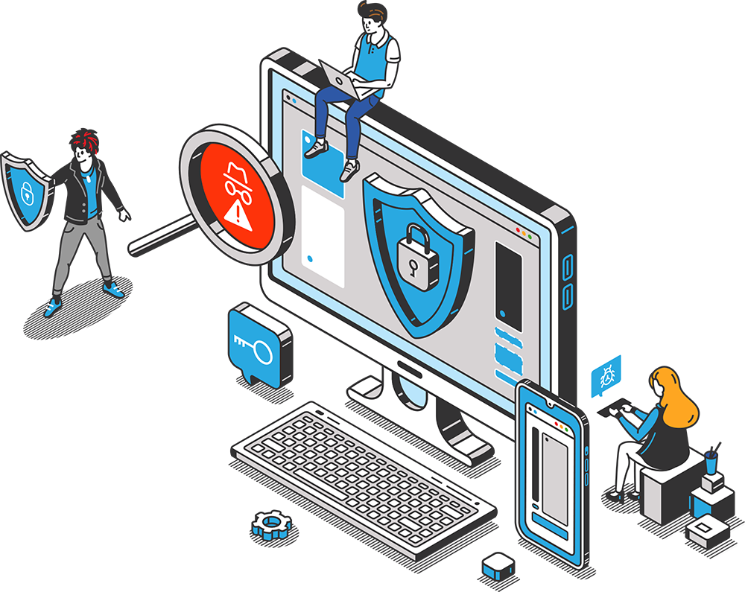
Computer Security Incident Reporting
Any unauthorized use or disclosure of Personally Identifiable Information (PII) must be reported in order to minimize any harmful effects or potential legal ramifications
Some incident examples that should be reported:
The unauthorized disclosure of PII
Loss or theft of a system(s) that contains PII
Virus suspected on any Squegg computer.
A data file is electronically transmitted to the wrong end user.
Network, System, or Data intrusion is detected
Sending unencrypted PII over public internet, including email.
Loss or theft of data backup media stored off site.

Slide 36
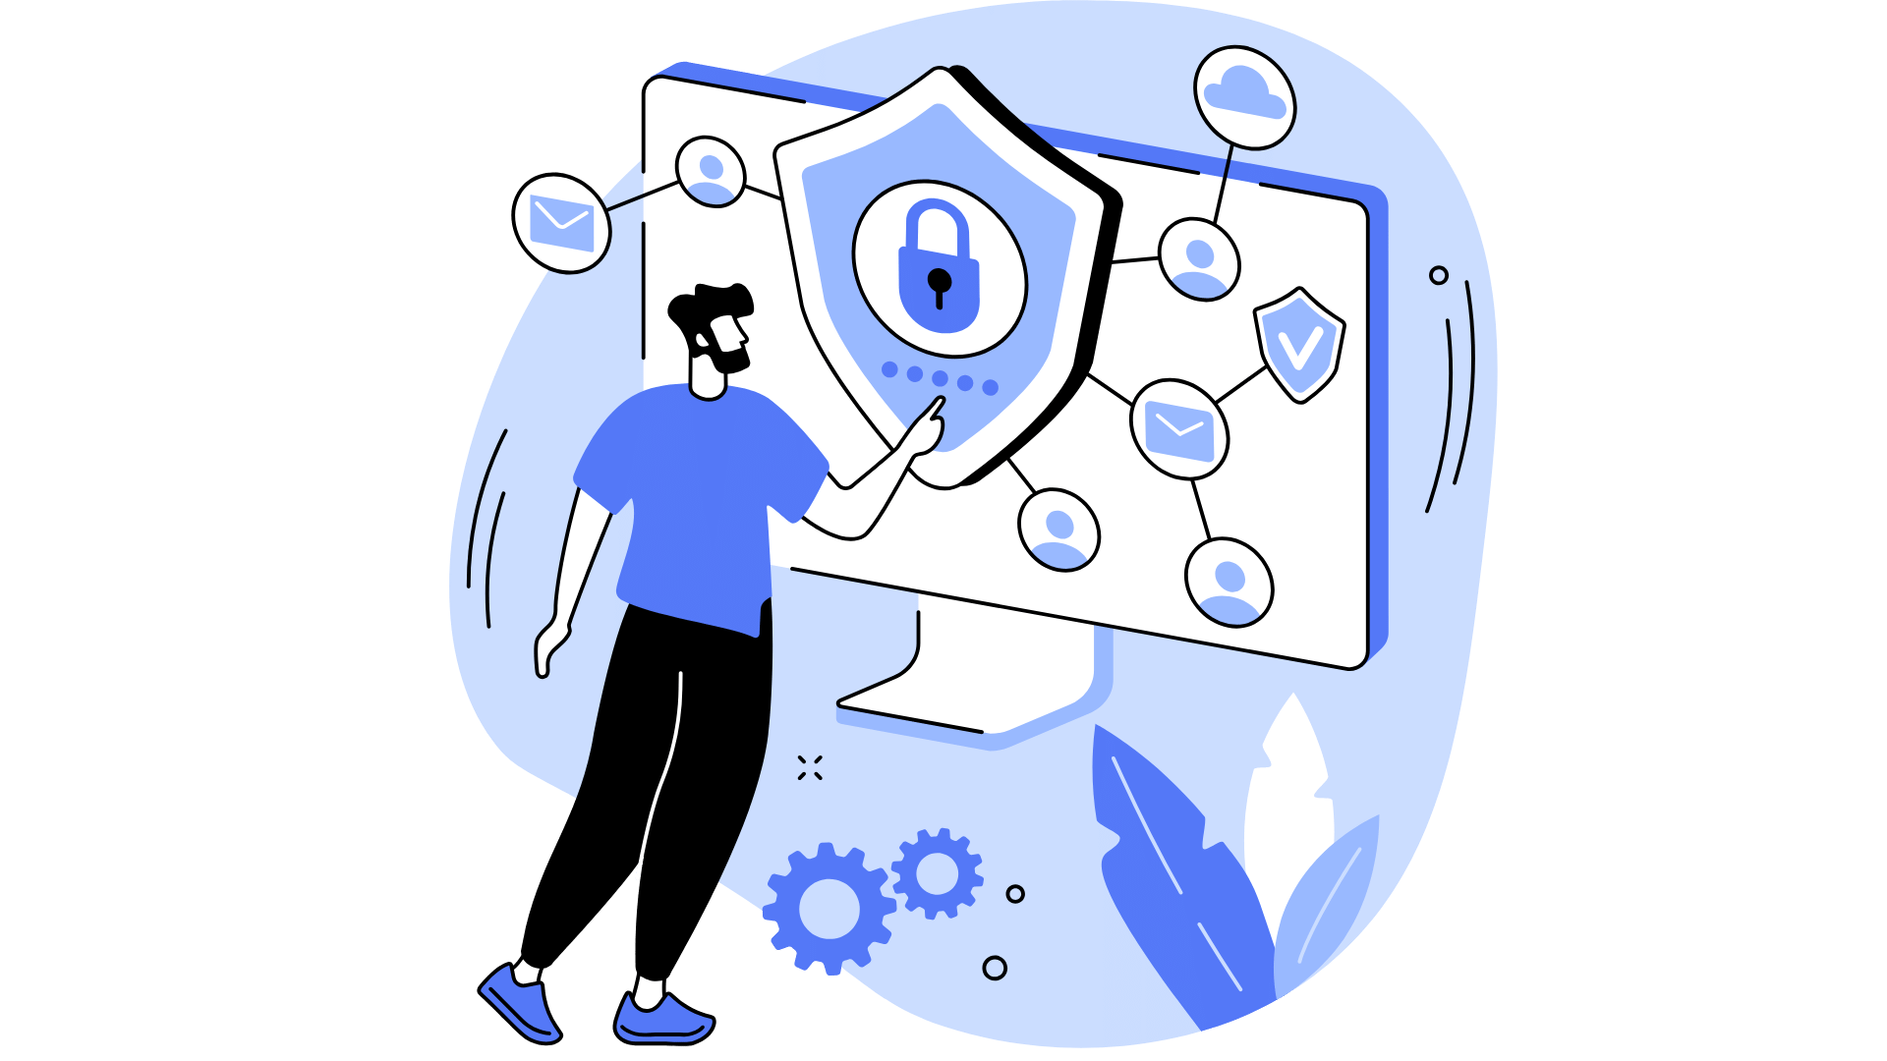
Best Practices for Keeping Your Home Network Secure
Migrate to a Modern Operating System and Hardware Platform
Install A Comprehensive Security Suite
Change Default passwords, SSID, Encryption Keys
Implement WPA2 on the Wireless Network
Implement Full Disk Encryption FDE
Download Software only from Trusted Sources
Limit Use of the Administrator Account
Update Application Software
Take Precautions on Social Networking Sites
Avoid Posting Photos with GPS Coordinates

Slide 37
Security Outside of the Office
Protect Information Systems While on Travel
Always maintain possession of your laptop and other mobile devices.
Ensure that the wireless security features are properly configured.
Be cautious when establishing a VPN connection through a non-secure environment (e.g., hotel). Do not work on sensitive material when using an insecure connection.
Turn off/disable wireless capability when connected via LAN cable.
Report a loss or theft of your laptop immediately to security POC.

Slide 38
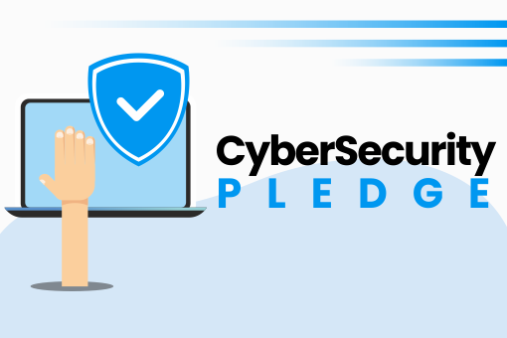
Take the Cyber Pledge!
Print and sign the pledge on the next slide and post it as a reminder.
Take the time and care every day to protect yourself,
your organization
and your clients through your own safe practices.

Slide 39
Cyber Security Pledge :
I, _____________________________________________ Date: _________________ PLEDGE to:
Stop, and Think (consider appropriateness and risk) before I Connect to the Internet.
Take personal responsibility for security, follow my organisation’s security policies, and adhere to sound security practices.
Lock my computer whenever I leave my work area.
Safeguard portable computing equipment when I am in public places.
Create and use strong passwords, and never share my password(s) with anyone.
Never leave a written password (sticky note, etc.) near my computer, or easily accessible.
Promptly report all security incidents or concerns to my organization’s security officer or other appropriate contact.
Safeguard “sensitive data” as well as confidential and/or legally protected (Personally Identifiable Information and Protected Health Information) data from any inappropriate disclosure.
Work to the best of my ability to keep my organization’s staff, property and information safe and secure.
Spread the message to my friends, co-workers and community about staying safe online.

Slide 40
